Slide 1
Image style transfer

Slide 2
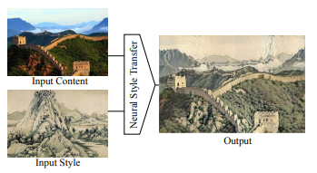
Problem definition
Image Style Transfer is the problem of taking a content image and a style image as input, and outputting an image that has the content of the content image and the style of the style image.

Slide 3
motivation
We want to show how well machine learning techniques perform on image processing and how artificial intelligence can, to some extent, achieve considerable success in the field of art and creativity.

Slide 4

APPLICATIONS
1.Social Communication

Slide 5
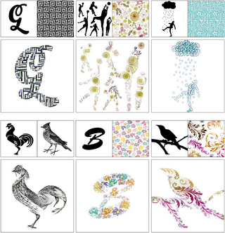
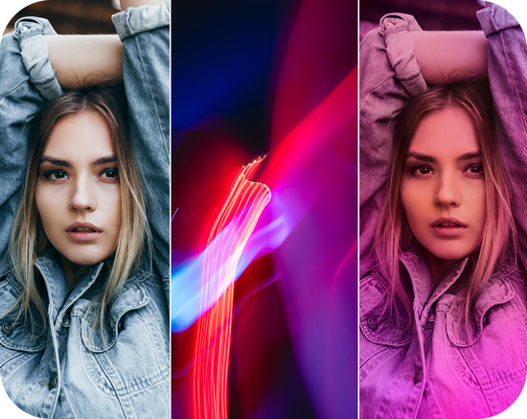
2.User-assisted Creation Tools

Slide 6
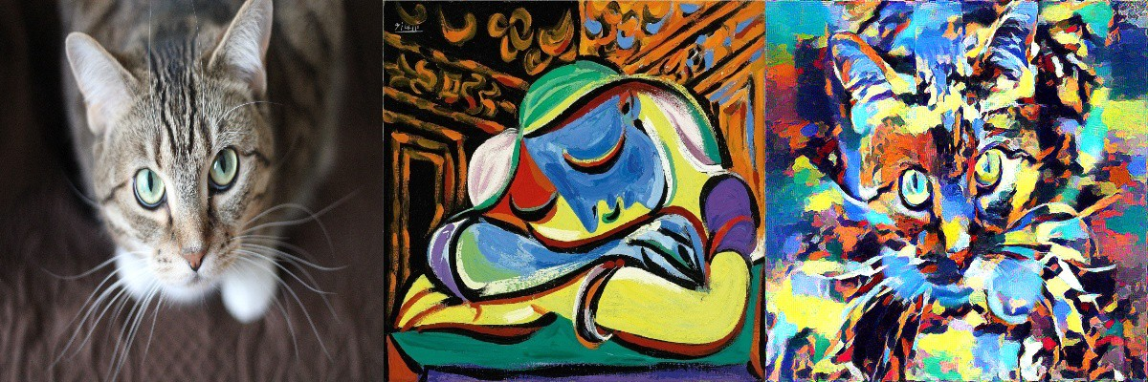
objective
We will create a program that make a image style transfer with a good accuracy.

Slide 7
introduction
Image style transfer method is a kind of computer image processing strategy that retains common photo content and adds certain artistic style.
The effect of style-transferred image caters to people's curiosity psychology and pursuit of beauty, and it has been widely praised and independently socialized.
This image style transfer method also has many practical applications in different fields, such as short video creation, live video, and film special effects.

Slide 8
First method

Slide 9
Neural network
Deep learning uses multi-layer neural network, which can automatically extract different features from the target object.
With the help of neural network, the extracted feature information is richer and the feature level is higher. Therefore, the neural network has excellent feature extraction ability and generalization ability correspondingly, which can effectively solve the traditional defects of artificial feature extraction algorithm.

Slide 10
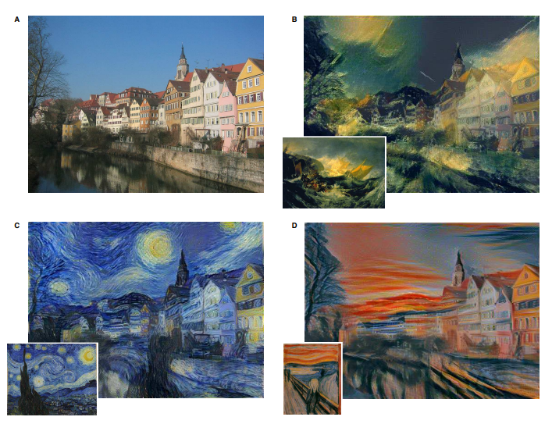
Gatys et al. [2-4]. put forward that texture can be represented by Convolution Neural Network (CNN)

Slide 11
How does it work?
1-take content image and style images and resize them to equal shapes.
2-load a pre-trained Convolutional Neural Network.

Slide 12
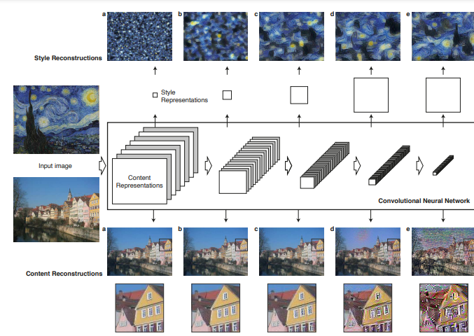

Slide 13
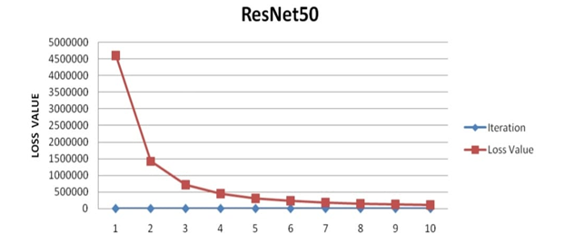
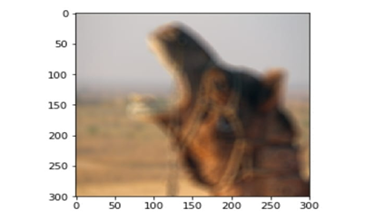
Image representation

Slide 14
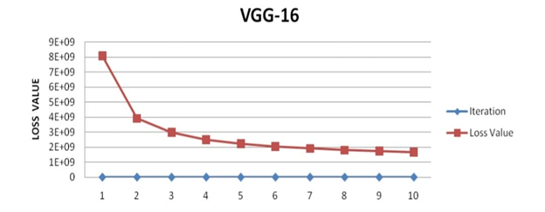
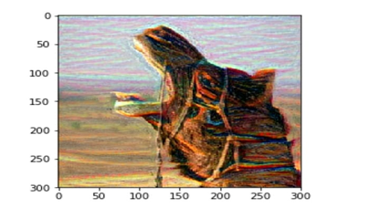
Vgg-16

Slide 15
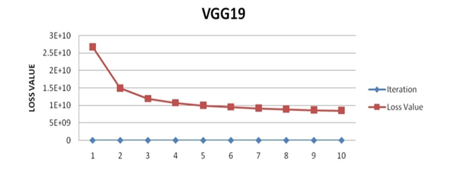
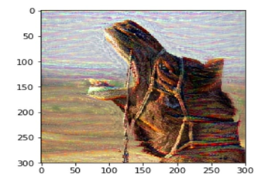
Vgg-19

Slide 16
3- our task is an optimization problem where we are going to minimize:
1.Content loss function.
2.Style loss function.
3-Total loss function.

Slide 17
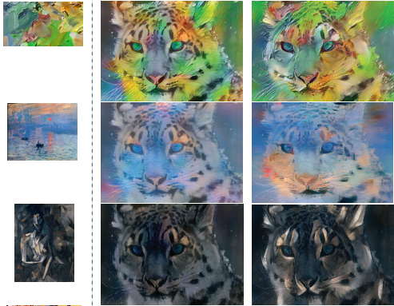
Stable and controllable neural texture synthesis and style transfer using histogram losses.
Gayts Risser et al.

Slide 18
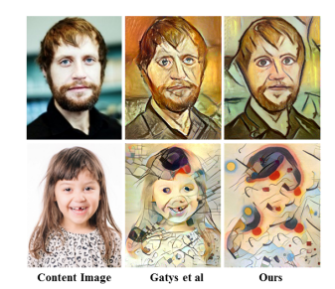
Combining markov random fields and convolutional neural networks for image synthesis.
Li and Wand

Slide 19
An overview of major style transfer loss functions
description | loss | author | paper
The first proposed style loss based on Gram-based style representations | Gram Loss | Gatys et al (2016) | Image style transfer using convolutional neural networks.
Matching the entire histogram of feature representations. Eliminating instability art efacts, compared with single Gram Loss. | Histogram Loss | Risser et al. (2017) | Stable and controllable neural texture synthesis and style transfer using histogram losses.
More effective when the content and style are similar in shape and perspective, compared with Gram Loss | MRF Loss | Li and Wand (2016) | Combining markov random fields and convolutional neural networks for image synthesis.

Slide 20
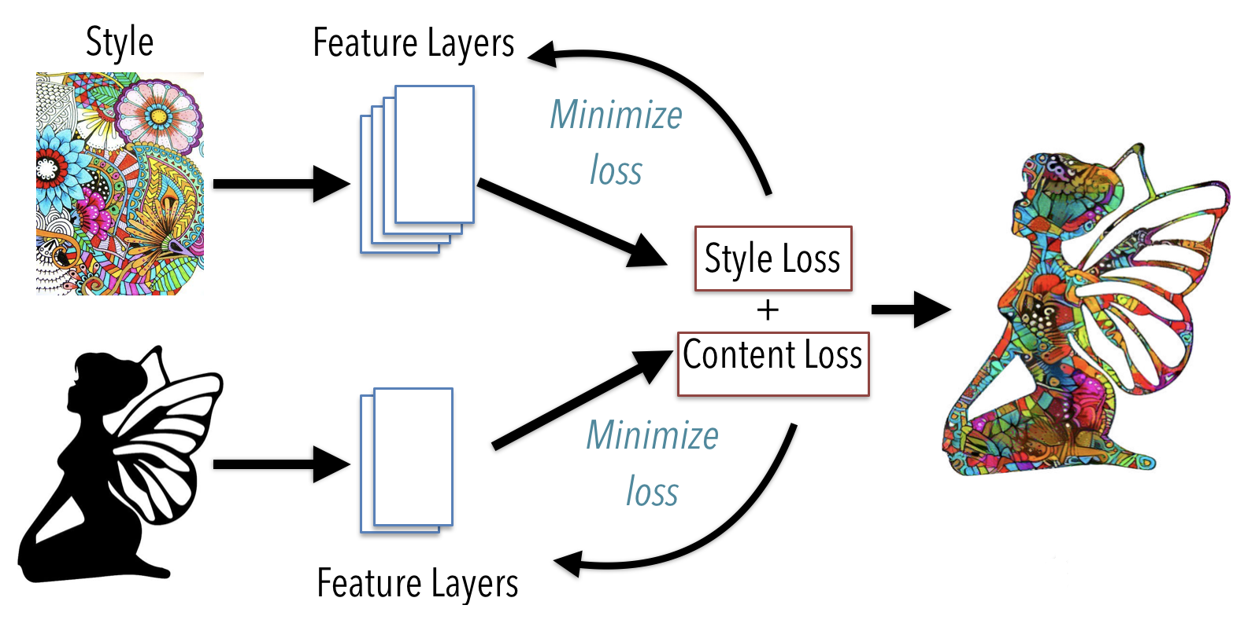
System architecture

Slide 21
tools

Slide 22
references
[1] Bruce, G., Amy, G. (2001) Non-Photorealistic rendering. AK Peters, Ltd., USA.
[2] Gatys, L. A., Ecker, A. S., Bethge, M. (2015) Texture synthesis using convolutional neural networks.
[3] Gatys, L. A., Ecker, A. S., Bethge, M. (2015) A neural algorithm of artistic style. Journal of Vision.
[4] Gatys, L. A., Ecker, A. S., Bethge, M. (2016) Image style transfer using convolutional neural networks. In: Computer Vision & Pattern Recognition.
[5] Lecun, Y., Bottou, and L., et al. (1998) Gradient-based learning applied to document recognition. Proceedings of the IEEE.
[6] Risser, E., Wilmot, P., Barnes, C. (2017) Stable and controllable neural texture synthesis and style transfer using histogram losses.
[7] Li, C., Wand, M. (2016) Combining markov random fields and convolutional neural networks for image synthesis. In: 29th IEEE Conference on Computer Vision and Pattern Recognition.
[8] Varun Gupta*, Rajat Sadana and Swastikaa Moudgil (2019) Image style transfer using convolutional neural networks based on transfer learning

